Slide 1

Name - Manjusha P. Bansod
Branch - Computer Science & Engineering
College- SIPNA College of Engineering & Technology, Amravati.
Topic- Instagram User Analytics–

Slide 2
Project Description
Project overview:
The project involves analyzing Instagram users to derive business insights.
The insights will be used by various teams across the business, including marketing, product development, and management.
Purpose of analysis:
The purpose of the analysis is to track user engagement and interactions with the Instagram software or mobile application.
This information will be used to derive business insights and make data-driven decisions.
Types of insights:
The insights derived from the analysis can be used to launch new marketing campaigns and improve the user experience.
The insights can also be used to track the success of the app by measuring user engagement and retention.
Role in the project:
The person writing the message is working with the product team on Instagram.
The product manager has asked the writer to provide insights on questions asked by the management team.

Slide 3
Approach
Approach to analyzing the dataset:
The writer's approach is to use a SQL Workbench to analyze the Instagram dataset.
This involves executing queries to read, manipulate, and summarize the data.
Use of an Entity Relationship Diagram (ERD):
An ERD is used to help understand the structure of the dataset.
It shows how many tables and columns are in the dataset and the relationships between them.
This helps with relating tables that have a one-to-one or one-to-many relationship.
Use of SQL operators, aggregation functions, and joins:
The writer uses various SQL operators, such as SELECT and WHERE, to query the dataset.
Aggregation functions, such as COUNT and SUM, are used to manipulate and summarize the data.
Joins are used to combine data from multiple tables in the dataset.
Purpose of using SQL:
The purpose of using SQL is to analyze the Instagram dataset and derive insights that can be used to make data-driven decisions.

Slide 4
Tech-stack Used
Speed and volume:
SQL is known for its speed and ability to handle large volumes of data without sacrificing performance.
This makes it ideal for working with large datasets and performing complex operations on them.
Collaborative and traceable:
SQL allows for collaborative querying, where users can save and share useful queries with others.
Queries can be traced back to see who made which changes to which table, making it easy to collaborate and track changes.
Organization and structure:
SQL tables are organized by rows and columns, which makes it easy to search and manipulate data in a structured way.
SQL tables are more strict about consistent data types, which helps prevent errors and ensures data accuracy.
Preparing data for analysis:
SQL can be used to prepare data for further analysis in other software or tools.
By querying and manipulating data in SQL, users can prepare data for use in machine learning models, statistical analysis, or other applications.

Slide 5
Insights
Importance of user analysis on Instagram:
User analysis is crucial for businesses and individuals who want to succeed on Instagram.
It provides valuable insights into user behavior and engagement.
Data collection and analysis:
Data collection and analysis are key components of the user analysis process.
This may involve collecting data on followers, engagement rates, and audience interests.
Use of insights for decision making:
The insights gained from user analysis can inform decisions about content creation, posting strategies, and engagement efforts.
These decisions can be data-driven and lead to continuous improvement and optimization.
Goal of user analysis:
The ultimate goal of user analysis on Instagram is to improve the account's performance and increase engagement rates.
This can help businesses and individuals connect with their audience and achieve their goals on the platform.

Slide 6
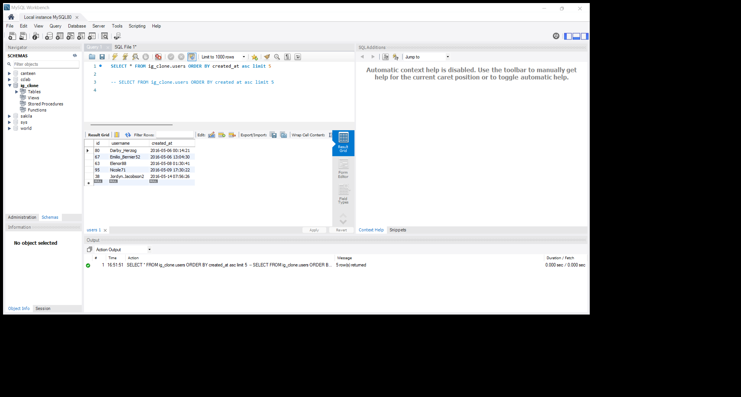
Marketing: the marketing team wants to launch some campaigns and they need your help to following
1. Rewarding Most Loyal Users: People who have been using the platform for the longest time. Your Task: Find the 5 oldest users of Instagram from the database provided
Those are the users who have been on the platform the longest.

Slide 7
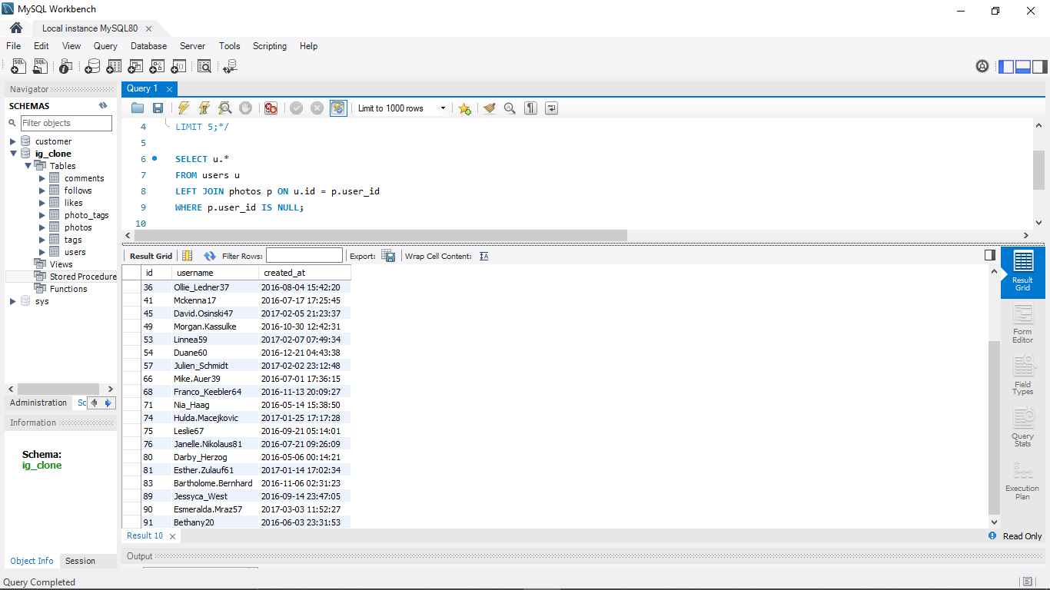
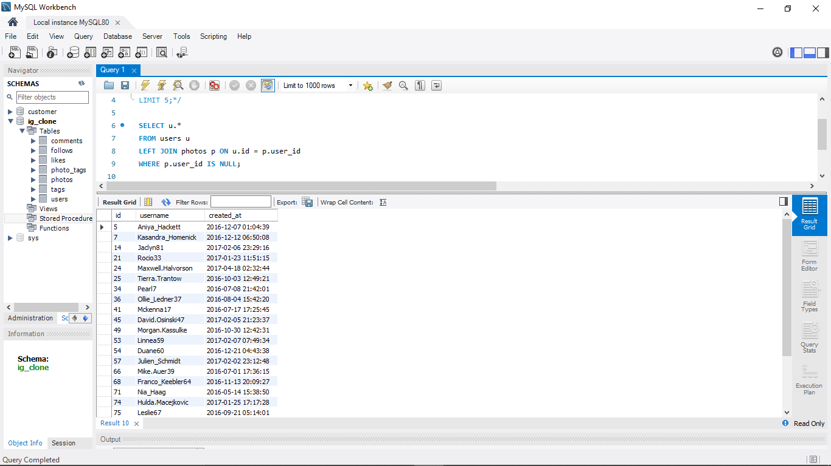
2. Remind Inactive users to start posting: by sending them promotional emails to post their first photos.
Your Task: Find the users who have never posted a single photo on Instagram.
There seem to be 100 people in total, but only 74 publish photos on Instagram, and 26 individuals have never shared a single photograph there.To upload their initial pictures, we need to send them a marketing email.The picture contains information about these 26 users.

Slide 8
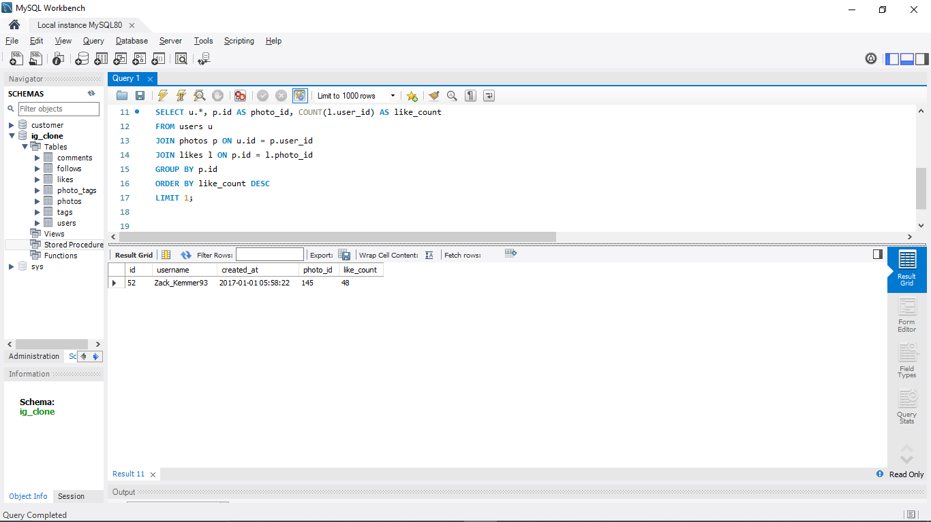
3. Declaring Contest Winner: the team started a contest and the users who get the most likes on a single photo will win the contest now they wish to declare the winner. Your Task: Identify the winner of the contest and provide their details to the team.
So Zack Kemmer93, whose ID is 52, wins the competition. One of his photos received 48 likes.

Slide 9
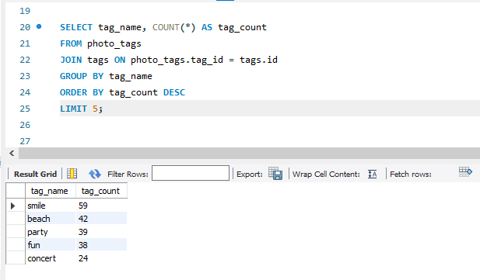
Hashtag Researching
Hashtag Researching: A partner brand wants to know, which hashtags to use in the post to reach the most people on the platform.
Your Task: Identify and suggest the top 5 most commonly used hashtags on the platform
Smile, Beach, Party, Fun, and Concert are the hashtags that people use the most frequently on the network. To reach the majority of platform users, Instagram might advise their partner to include these in their new post.

Slide 10
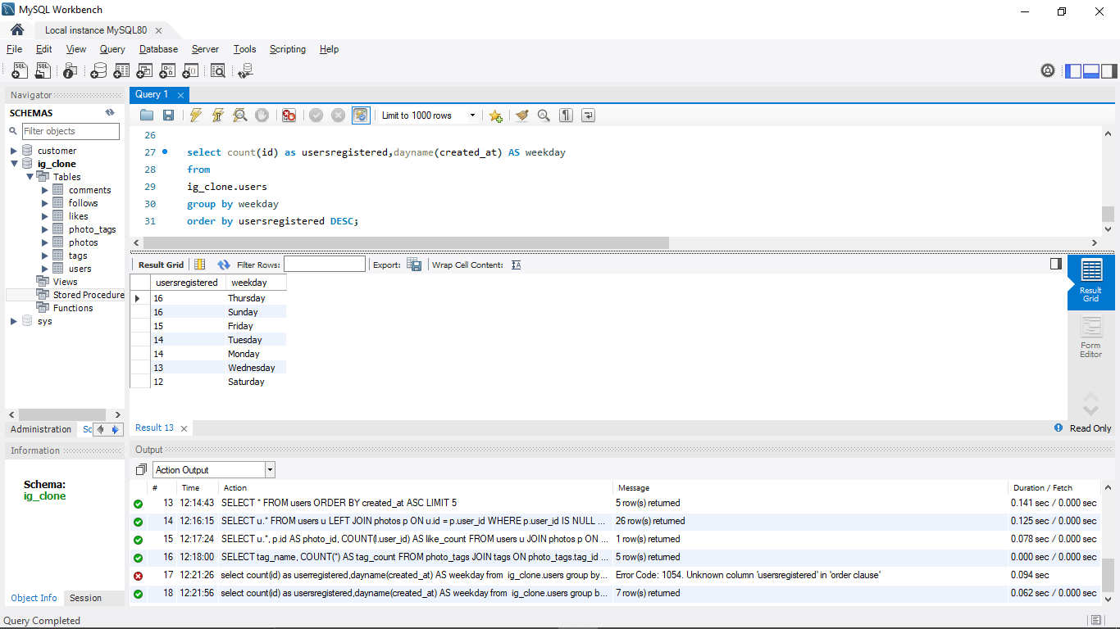
Launch AD Campaign: The team wants to know, which day would be the best day to launch ADs. Your Task: What day of the week do most users register on? Provide insights on when to schedule an ad campaign
As most people registered on Thursday and Sunday, these days would be ideal for launching the advertisement in order to reach the most possible audience.

Slide 11
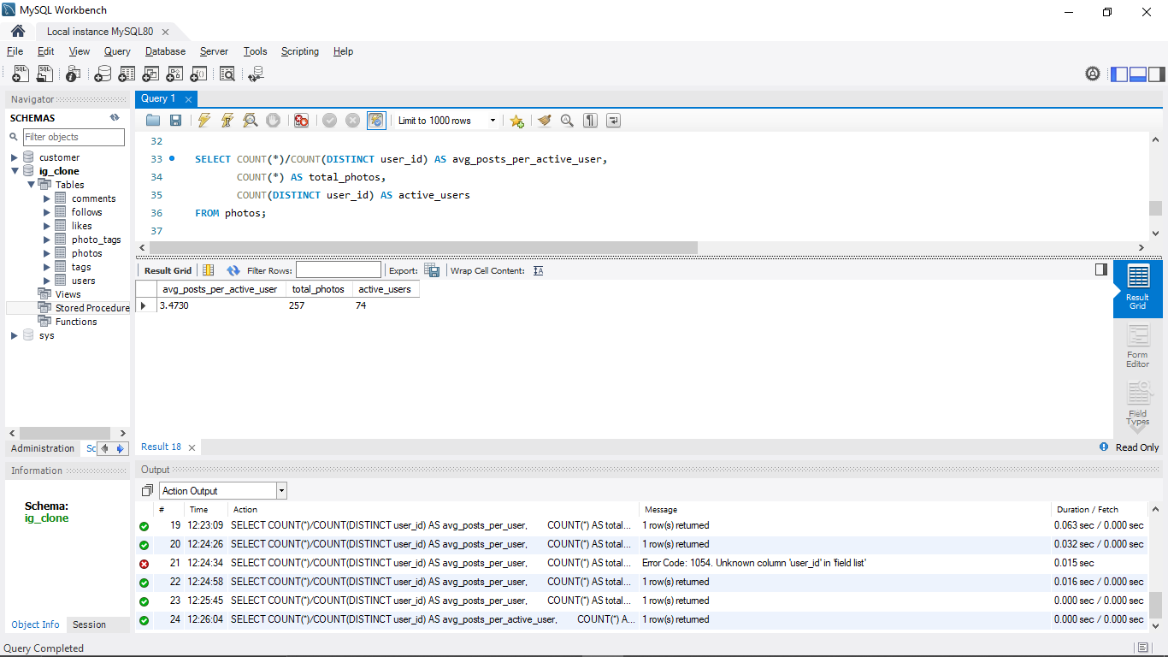
B) Investor Metrics: Our investors want to know if Instagram is performing well and is not becoming redundant like Facebook, they want to assess the app on the following grounds
User Engagement: Are users still as active and post on Instagram or they are making fewer posts Your Task: Provide how many times does average user posts on Instagram. Also, provide the total number of photos on Instagram/total number of users
There are 100 users overall, and there are 257 posts overall. An Instagram user typically uploads 3–4 photographs every year.

Slide 12
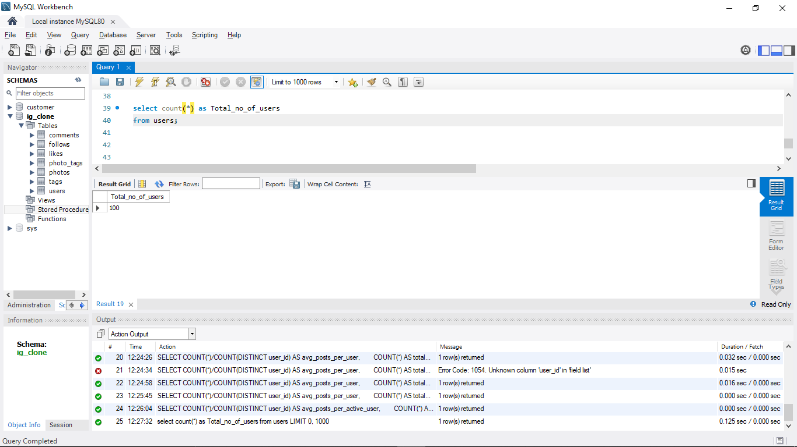
Investor Metrics: Our investor wants to know if Instagram is performing well and is not becoming redundant like Facebook wants to know, they want to assess the app on the following grounds. 1. Users Engagement: are users still as active and post on Instagram or they are making few posts Your Task: Provide how many times does average posts on Instagram. Also, provide the total number of photos on Instagram/ total number of users.

Slide 13
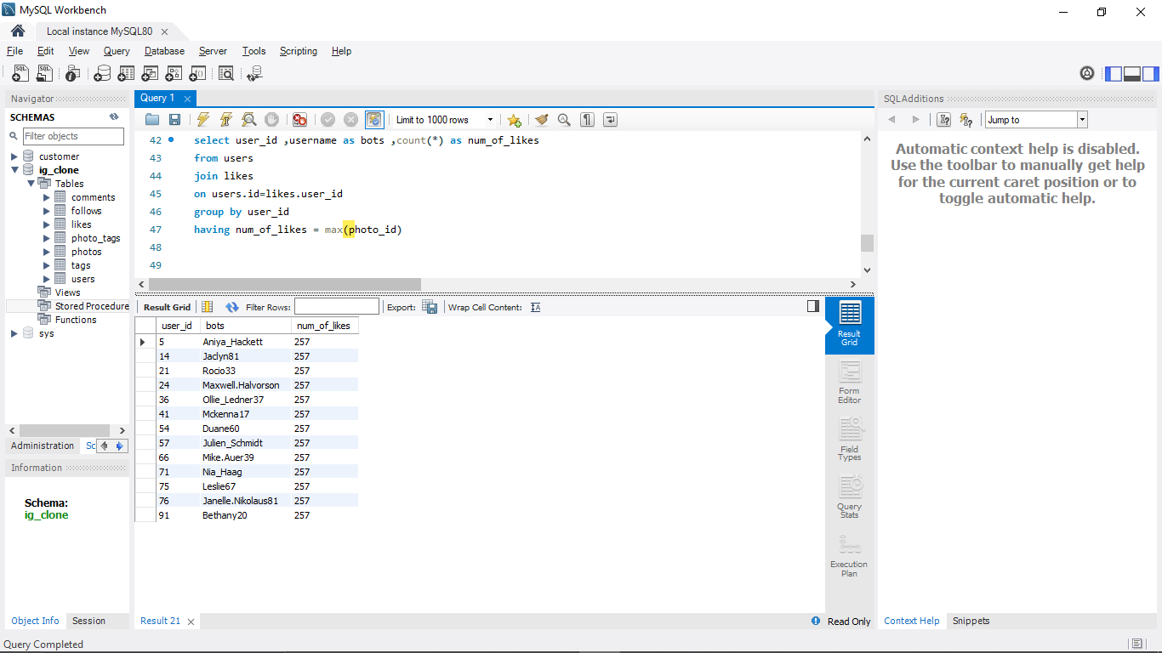
2) Bots & Fake Accounts: The investors want to know if the platform is crowded with fake and dummy accounts Your Task: Provide data on users (bots) who have liked every single photo on the site (since any normal user would not be able to do this)
13 accounts in total were found to be spamming people on Instagram. The user ID and IP address can be used to locate and remove these phone accounts.

Slide 14
Summary:
Top 5 oldest customers:
The top 5 oldest customers, who are considered to be the most loyal ones, created their accounts in the month of May.
Darby was the first one to register.
Users who have never posted a single picture:
There are 5 users who have never posted a single picture on Instagram as of yet.
Contest winner:
The contest winner is Zack_Kemmer93, whose id is 52, and who gets 48 likes on a single photo.
Most commonly used hashtags:
These are the 5 most commonly used hashtags on the platform: smile, beach, party, fun, concert.
Bots on the platform:
There are 13 bots on the platform that could fill the app with spam and irrelevant content.
Registration days:
It was found that Thursdays and Sundays were the days when most users registered.
Average number of photos posted:
On average, a user was posting 3-4 photos in a year.

Slide 15
Result
A computer language called SQL is used to manage and analyse data in relational databases.
Data retrieval, data manipulation, and the creation and analysis of metrics are all possible using SQL.SQL is utilised in many different sectors and is crucial for jobs that need data analysis.
SQL has a standardised syntax and sophisticated features for analysing complex data.
Understanding databases and being proficient in SQL syntax and basic commands are prerequisites for learning SQL.

Slide 16
THANK YOU

